Slide 1
SNOOZELES Alarm Clock
The solution for your lazy mornings
Eden Daniel Linoy Erez Noa Hausman Koren Segal

Slide 2


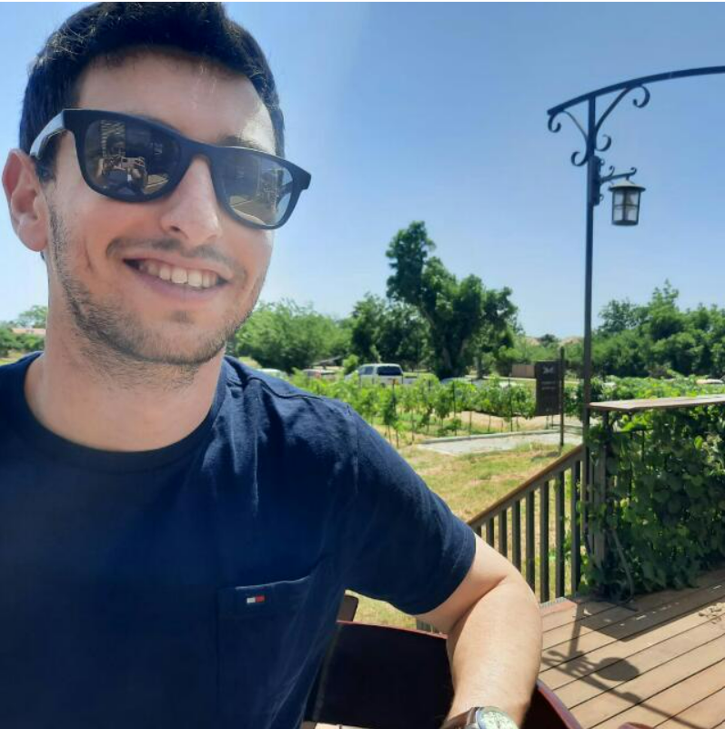
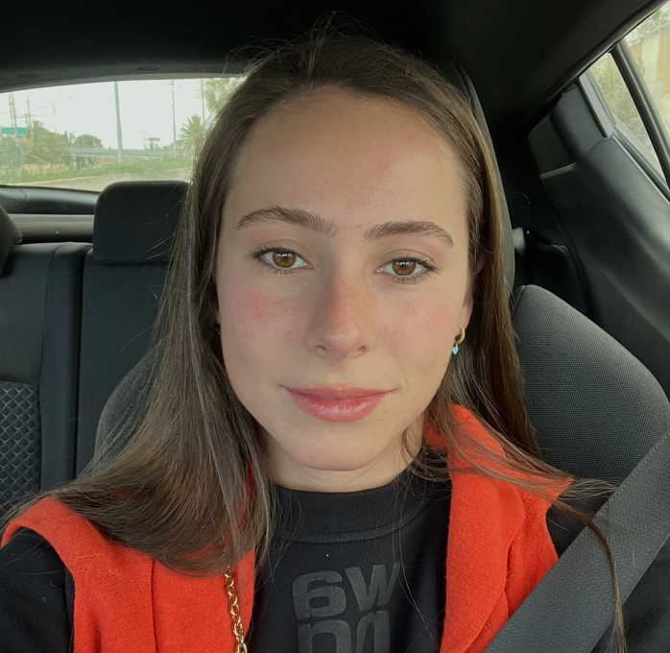

Our team
Noa
Linoy
We are Computer Science students from Israel, on our 3rd year of studies.
Koren
Eden

Slide 3
Today’s Topics
01
02
03
The Problem
Our Solution
The Future
In routine, most people use an alarm clock to help them wake up every morning. Although the alarm is used regularly, It sometimes fails to serve its purpose – people would go back to sleep even after it goes off.
A smart alarm clock which rings continuously until it ensures the person is fully awake and out of bed. Our solution is an entire product, composed of both a physical and a virtual system, working together.
Although our current product contains many necessary functionalities, we still have ideas for future development and possible features to add later on. A few of them will be discussed later.

Slide 4
01
The Problem

Slide 5
—Dr. Guy Meadows
“People who are able to produce more sleep spindles may be hard to wake because they can effectively cancel out the noise that is attempting to disturb their sleep.”
Co-founder and clinical lead at Sleep School, London

Slide 6
02
Our Solution
Snoozeless Alarm Clock

Slide 7
A smart alarm clock which will ring continuously until it ensures the person is fully awake and out of bed.
Our solution is composed of a physical alarm device, a web page for setting the time, two belts with IMU sensors for collecting the data, and a data analysis page for the user to keep track of his progress.

Slide 8
The System Flow
01
02
03
04
Alarm starts
User sets an alarm
When the selected time arrives
Through the website
Alarm stops
Prediction starts
The user can set a new alarm
It is done on the data sent by the IMUs, the ML estimates one’s current state until a positive prediction
System saves data for analysis
05
Data is aggregated to generate long term analytics of the user’s activity

Slide 9
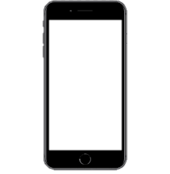
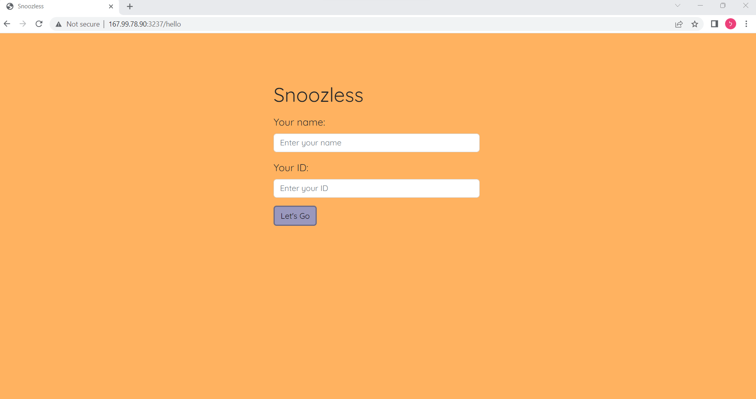
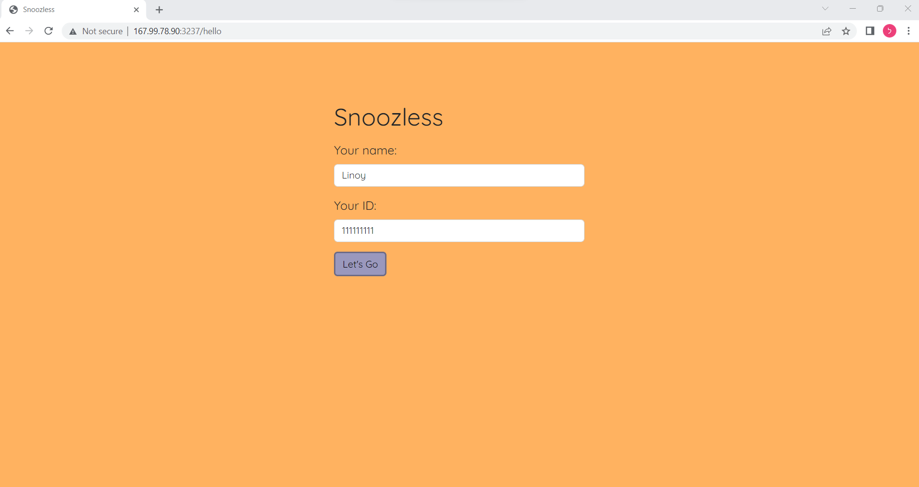
The System Flow
Filling name and ID

Slide 10
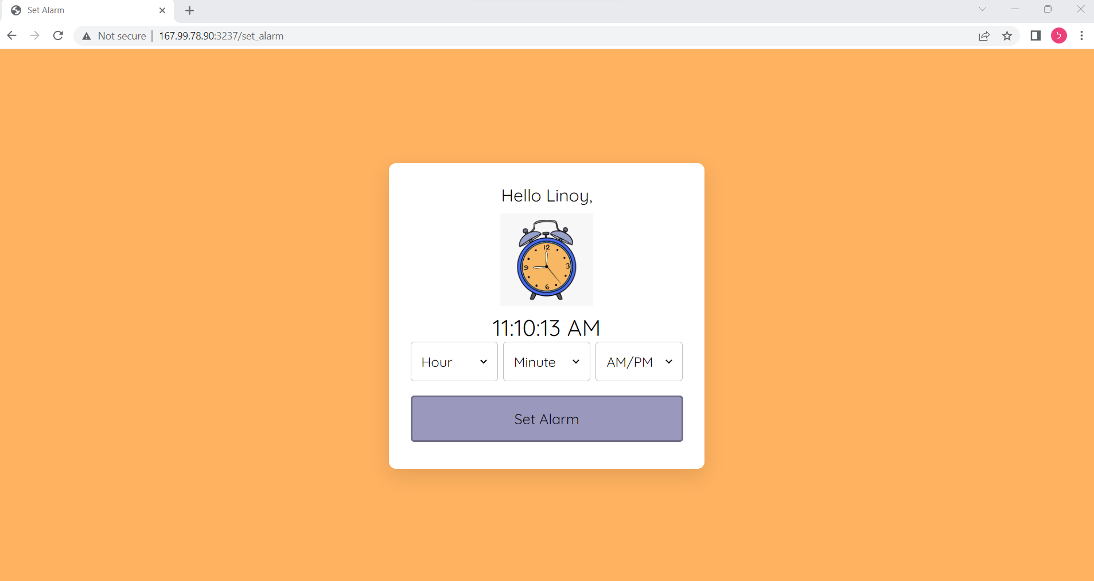
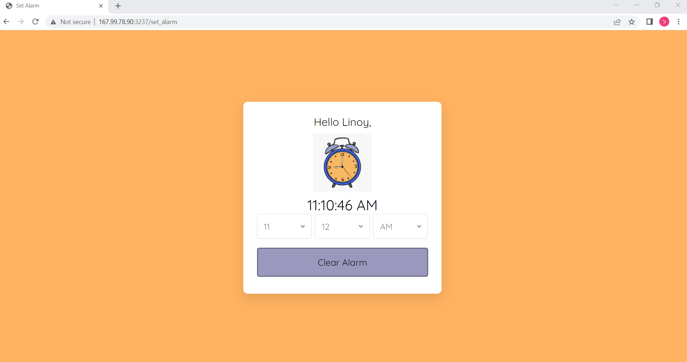
The System Flow
Setting the time

Slide 11
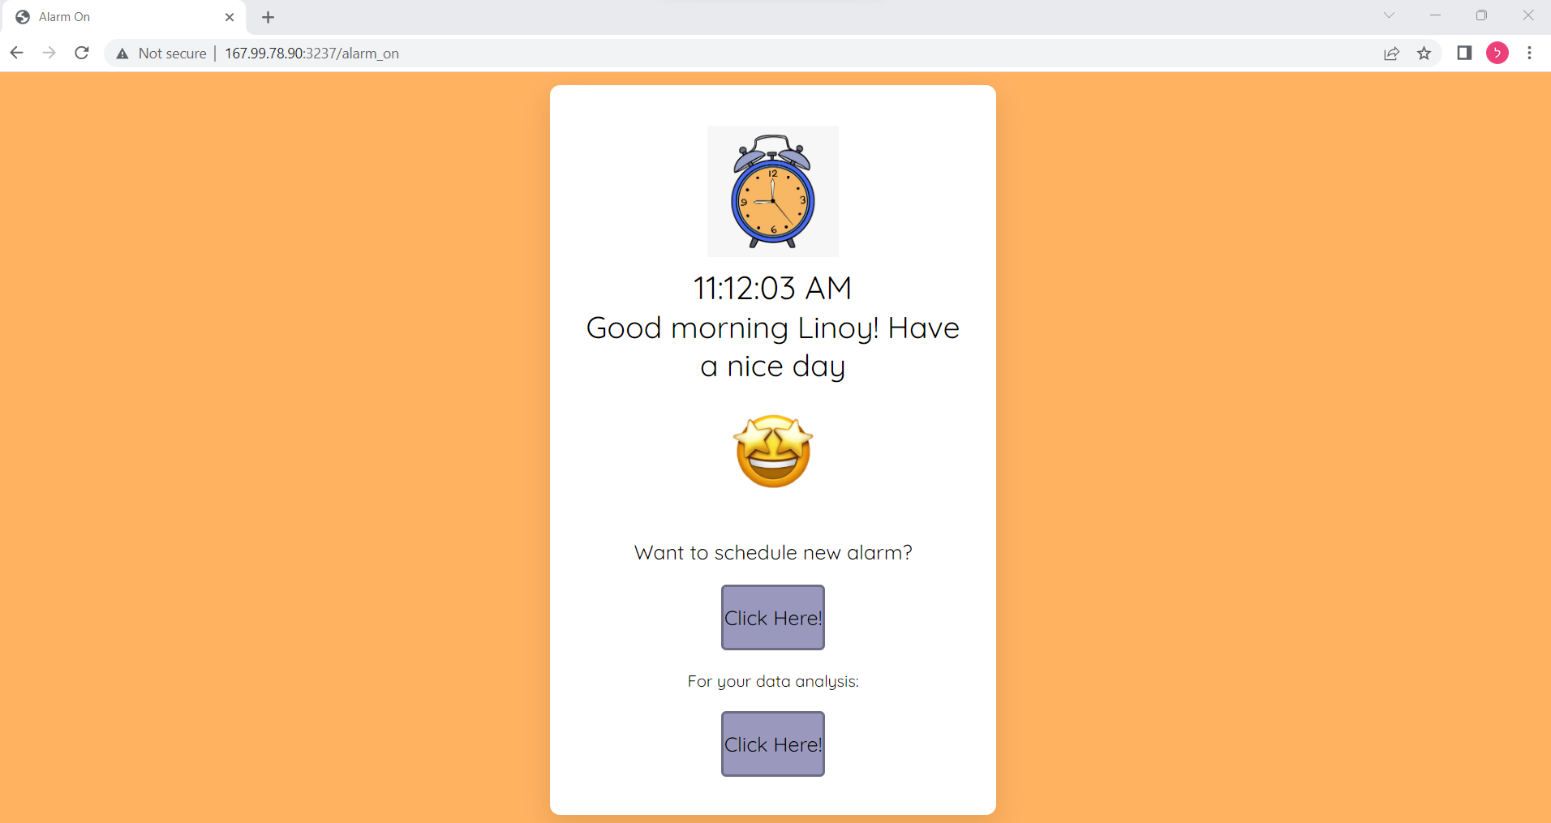
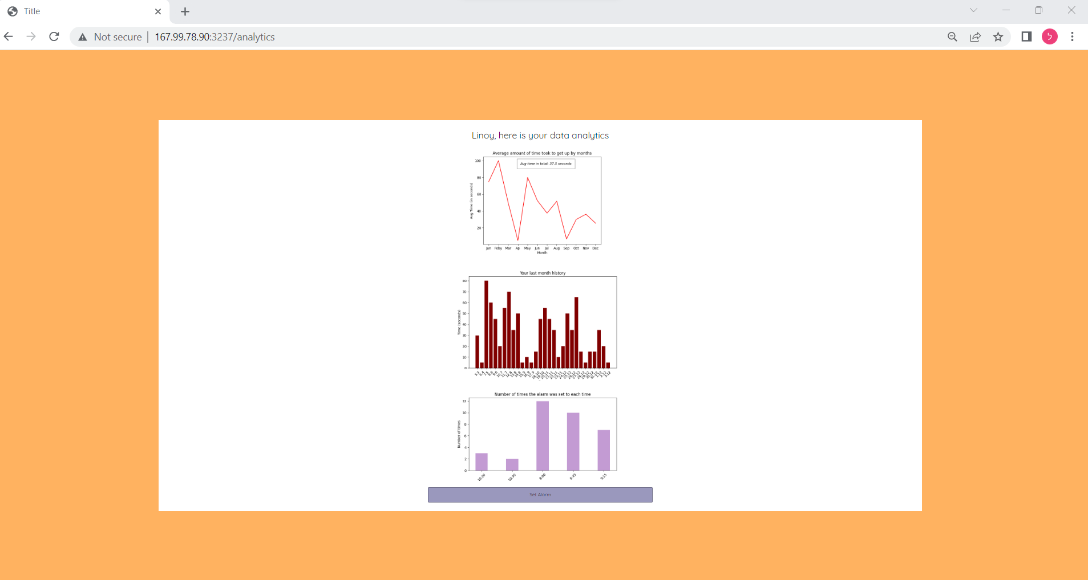
The System Flow
Press on Analytics Page

Slide 12
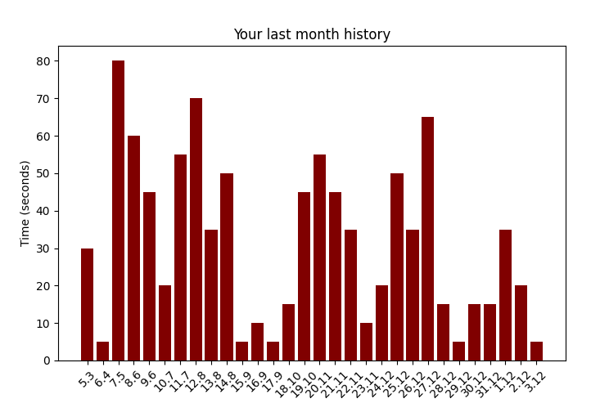
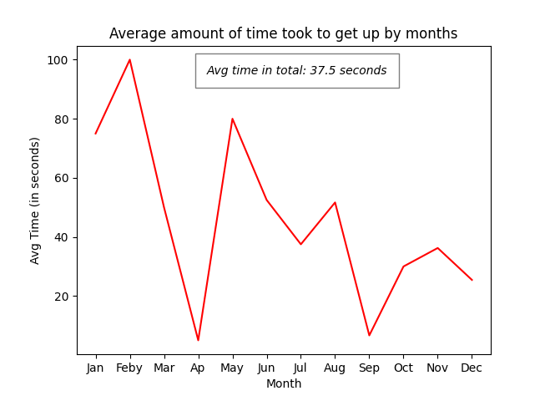
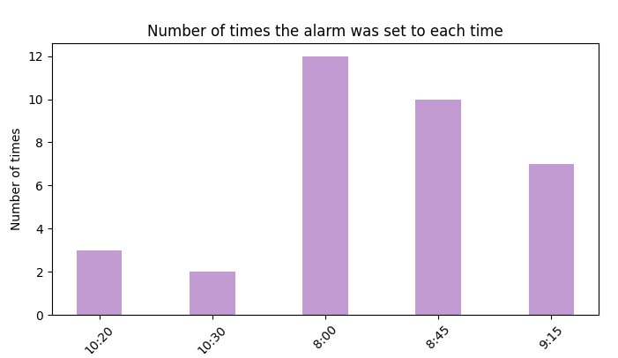
Long Term Analytics
Alarm Routine - the user can see how many times he/she set the alarm for each hour.
Data History - the user can see how much time it took him/her to wake up on each day of the last 30 days.
Average Time - the user can see how much time took him/her to get up on average, for each month.

Slide 13
System Architecture
💻
⌛
📱
user
Storage
Analytics
ML
Data
WeMos
IMU
IMU
⏰
buzzer
WeMos

Slide 14
What’s new?
Cloud server – the entire system runs remotely
Long term analytics – users can learn about their behavior
Main functionality moved to backend – events are now handled by the cloud server only
Database – for managing shared information
POST requests
Multiple users – users can set alarms anytime anywhere
Physical clock – wraps the clock’s components together

Slide 15


Slide 16
Features
Edit current alarm
Observe personal analytics
Multiple Users
Current time display

Slide 17
03
The Future
How can we continue to grow

Slide 18


Ideas For The Future
Sleep cycles – the system collects data while the user is sleeping. We want to use this data to detect REM cycles and improve the ML model by taking into consideration the person’s sleep state.
Personal recommendations – based on the personal long-term analysis collected, advise the user some personal improvements (for example – the most effective time to go to sleep on Tuesdays).
Voice detection - Add voice detection for a better ML model
User calendar synchronization - Sync with the user’s calendar to recognize schedule overlaps.

Slide 19
Thanks!
Do you have any questions?
Eden Daniel Linoy Erez Noa Hausman Koren Segal

